Slide 1
A Statistical Analysis on Popularity and Diversity
Jiameng Ma| Leiden, Netherlands

Slide 2
Introduction
Why Playlists Matter?
Playlists are central to modern music consumption, especially in the streaming era. They reflect listening preferences, moods, and trends.
Study Aim--- Examine 20 years of playlist creation to uncover:
Changes in how people create playlists..
How technological innovations have impacted these processes..
Key Concepts---
Popularity: Frequency and influence of tracks in playlists.
Diversity: Variety of musical elements within playlists.

Slide 3
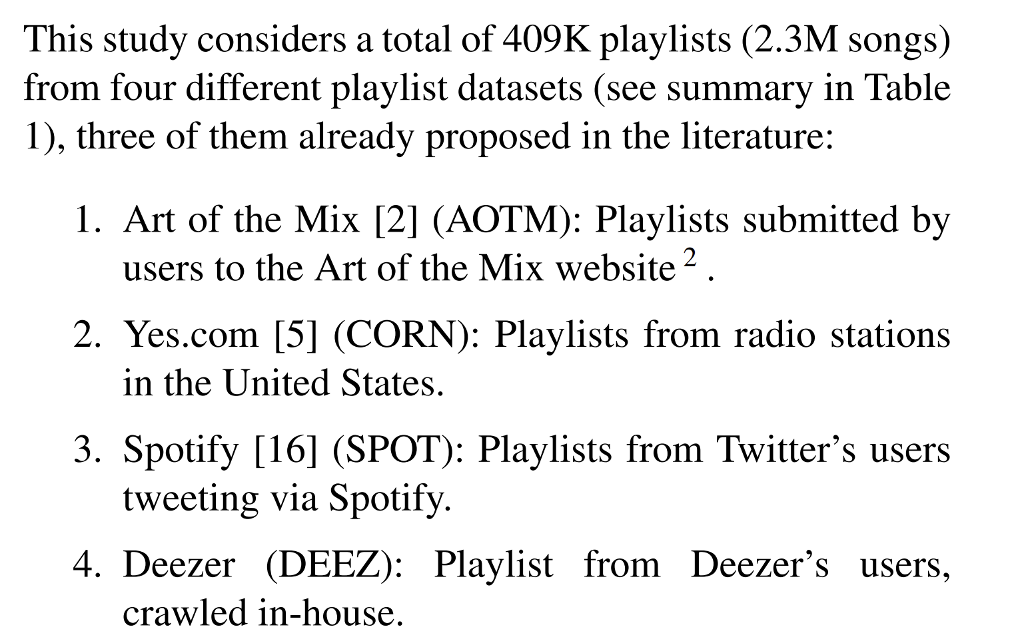
Methodology Overview
Metrics Introduced:
Popularity:
Track Popularity Index : Frequency of a track in playlists.
Playlist Popularity Index: Average popularity of tracks in a playlist.
Diversity：
Playlist Diversity Index : Semantic distance between tracks based on Last.fm tags.

Slide 4
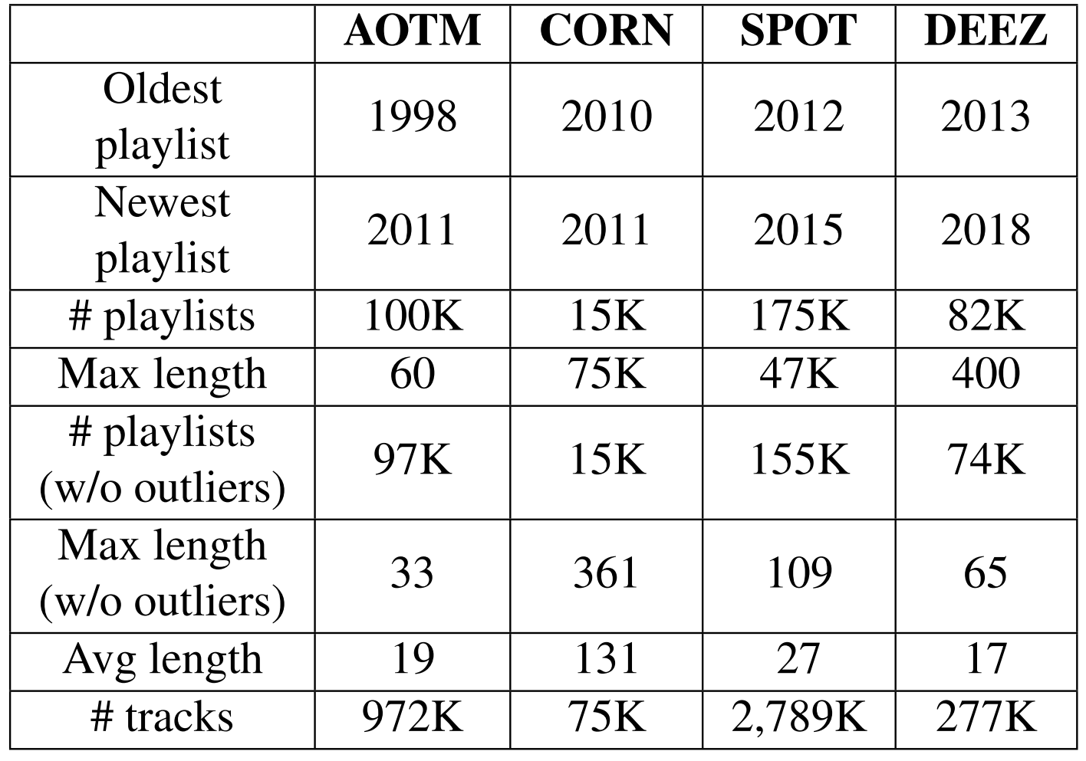
Dataset Characteristics
Dataset Details:
AOTM: User-generated, pre-streaming playlists from 1998–2011 (97K playlists).
CORN: Radio playlists, genre-diverse, commercial constraints.
SPOT & DEEZ: User-generated, streaming-era playlists.
Pre-processing:
Filtered out playlists with <4 unique tracks.
Removed outliers (extremely long playlists).

Slide 5

Popularity Analysis
Track Popularity Index (tPI):
Frequency of a track across all playlists in a dataset.
Tracks grouped into 10 popularity levels (e.g., 0–0.1, 0.1–0.2).
Findings:
Radio playlists (CORN): High tPI concentration, with many popular tracks.
User-generated playlists:
AOTM: Dominated by niche tracks (99.99% in the lowest tPI range).
SPOT & DEEZ: More balanced.

Slide 6
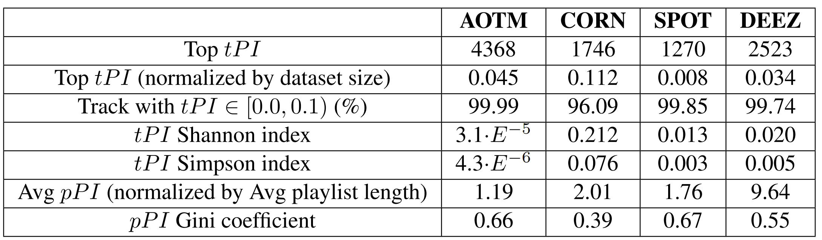
Playlist Popularity
Key Insights:
CORN: Balanced popularity due to curated policies
DEEZ & SPOT: Streaming algorithms favor balance but include popular tracks
AOTM: High imbalance, influenced by niche tracks and lack of streaming
Playlist Popularity Index (pPI):
Average tPI of tracks in a playlist
Gini coefficient used to measure imbalance

Slide 7

Diversity Analysis
Semantic Diversity:
Based on Last.fm tags (e.g., "rock," "jazz")
Measures distance between tracks using tag embeddings
Results:
Radio playlists (CORN): Higher diversity, fewer single-artist playlists
Streaming playlists (SPOT & DEEZ): More diverse than AOTM
AOTM: Low diversity, many playlists focused on single genres/artists

Slide 8
Results Summary
Diversity:
CORN: Highly Diverse due to track variety
AOTM: Limited by user preferences and pre-streaming limitations
DEEZ & SPOT: Higher diversity supported by recommendation systems
Popularity:
CORN: Curated playlists prioritize popular tracks
DEEZ & SPOT: Streaming platforms blend popular and niche content
AOTM:Prioritizes the most popular tracks, with the highest and low diversity indices, reflecting a strong focus on mainstream content.

Slide 9

Implications
Future Research:
Explore regional and cultural differences
Analyze playlists longitudinally (e.g., yearly trends)
Incorporate track order into diversity analysis
Impact of Streaming:
Accessibility increases diversity and reduces bias toward niche tracks
Recommendation algorithms shape user decisions

Slide 10
Conclusion
Summary:
Playlist creation has evolved significantly due to streaming
Popularity and diversity reveal shifts in music consumption patterns
Contributions:
Novel metrics for playlist analysis
Open access to data and methods for reproducibility
Impact of Streaming:
Streaming empowers diversity but maintains some focus on popularity

Slide 11
Thanks for listen

